Slide 1
CS 4350: Fundamentals of Software Engineering CS 5500: Foundations of Software Engineering Lesson 7.1 Bugs
Jon Bell, John Boyland, Mitch Wand
Khoury College of Computer Sciences
© 2021 Jonathan Bell, John Boyland and Mitch Wand. Released under the CC BY-SA license

Slide 2
Outline of this lesson
How a project should handle bug reports
Effective debugging

Slide 3
Learning Objectives for this Lesson
By the end of this lesson, you should be able to:
Describe best practices around bugs;
Distinguish the concept of where a failure is manifest versus where fault is in execution;
Contrast synchronic (in current code) versus diachronic (in changes) fault-locating;
Review the basic operations provided by debuggers.

Slide 4

What to Do When a Bug is Reported
Log the issue in a tracking system
Many possibilities: github issues, Bugzilla, gerrit, … .
Connect to symptoms, tests, causes and fixes.
User-searchable helps prevent duplicate/invalid reports.
In an open-source project, recent activity gives confidence to users that the project is still live.
4

Slide 5
First Steps
Assign a priority
How crucial it is to fix the problem.
Assign a responsible party
Not blame: rather who will work on it first.
Try to find a Short Self-Contained Correct Example
S: remove everything that is not necessary;
S-C: add everything needed to demonstrate problem;
C: the example is valid;
E: a concrete example of bug behavior.
(Ideally reporter gives one or gets close.)

Slide 6
Assignee tasks
The assignee needs to investigate the report to see if it is actionable, or else it is …
Invalid: not relevant to the software
Duplicate: already reported
Fixed: in a recent version
Can’t reproduce: back to reporter for more data
Otherwise, if the bug is reproducible:
Complete SSCCE if not already done.
Convert SSCCE into a (failing) test:
Small scope and automated, if possible.
You may recall this step from TDD

Slide 7
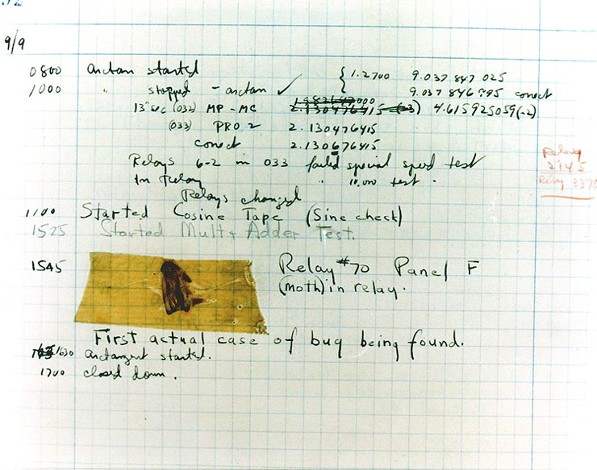
“Debugging”
The term “bug” (or a “glitch”) dates at least back to Thomas Edison in the 19th century.
”Debugging” also predates the famous bug found in Mark II, as related by Admiral Grace Hopper.

Slide 8
Debugging has Two Phases
Diagnosis
Determine the fault causing the problem observed.
For example:
Faulty computation;
Incorrect assumption;
Mis-use of another component.
Correction
Correct the fault so that test passes (and none fail).
For example:
Fix computation;
Add code to handle unhandled cases.
Basically, coding

Slide 9
Anti-Pattern: Mutation Debugging
Avoiding diagnosis is a mistake.
If you don’t understand what’s going wrong, how can you fix it?
Mutation debugging:
Make a change to the program
Re-run all tests.
Repeat unless all pass.
A (poor) version of genetic programming, with similar (unmaintainable) results.
Mutate
Program
Run
Tests
Tests fail
Tests pass

Slide 10


(Synchronic) Fault Location
Initially, fault must lie between program start and failure point.
Use tools to narrow dynamic scope.
Iterate until fault located.
”Wolf Fence” technique of Edward Gauss
A form of Binary Search

Slide 11
Diachronic Fault Location
If the fault was not present in an earlier version, we can use diachronic fault location to find when it was introduced.
Same binary search approach, but this time over the versions of software.
git bisect
This uses an automated test to indicate presence.
Commit 1 (no error)
Commit 2
Commit 3
…
Commit introducing fault
...
Commit N (error present)

Slide 12
Debugging as Hypothesis Testing
Guessing a diagnosis:
Experience (pattern matching);
Community (colleagues, stackoverflow.com);
Information from faulty run.
Verbalize hypothesis:
Good for bug reporting system;
Direct debugging actions.
Testing a diagnosis:
Use debugging techniques to test;
Better once fault located to a narrow area.

Slide 13
Using Debugging Tools
Techniques:
Print statements,
Special-purpose code changes (e.g., assertions),
Breakpoints,
Stepping,
Watchpoints.
Use tools for a purpose:
Fencing the wolf;
Testing the hypothesis.

Slide 14

Assisting Future Debugging
Assisting fault location:
“fail-fast”: stop as soon as problem noticed;
Check invariants frequently during testing.
Assisting hypothesis testing:
Make assumptions explicit (and checked!);
Log interactions with other components.

Slide 15
Review: Learning Objectives for this Lesson
You should now be able to:
Describe best practices around bugs;
Distinguish the concept of where a failure is manifest versus where fault is in execution;
Contrast synchronic (in current code) versus diachronic (in changes) fault-locating;
Review the basic operations provided by debuggers.

Slide 16
Next steps...
In our next lesson, we’ll discuss using git in teams.

